Slide 1

B.Tech I-Year II-Sem
Subject: UI FRAMEWORKS
(MR23-1CS0106)

Slide 2
UNIT-II REACTJS-PART-II

Slide 3

Syllabus-UNIT II
React Events,
React Lists,
React Keys,
React Refs,
React Fragments,
React Router,
React Styling using React Bootstrap,
React Map,
React Table
Higher-Order Components,
React Code Splitting,
React Context,
React Hooks,
React Redux.

Slide 4
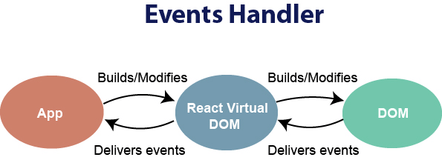
React Events
An event is an action that could be triggered as a result of the user action or system generated event. For example, a mouse click, loading of a web page, pressing a key, window resizes, and other interactions are called events.
React has its own event handling system which is very similar to handling events on DOM elements. The react event handling system is known as Synthetic Events. The synthetic event is a cross-browser wrapper of the browser's native event.

Slide 5
React Events
Handling events with react have some syntactic differences from handling events on DOM.
These are:
React events are named as camelCase instead of lowercase.
(Eg.:onClick instead of onclick)
2. With JSX, a function is passed as the event handler instead of a string.
Event declaration in plain HTML:
<button onclick="showMessage()"> Hello MRU </button>
Event declaration in React:
In Functional Component:<button onClick={showMessage}> Hello MRU </button>
In Class Based Component: <button onClick={this.showMessage}>Hello MRU</button>

Slide 6
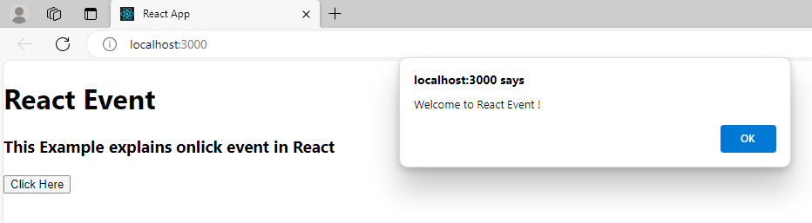
React Events-Example
import React from 'react';
function event() {
const alertBox = () => {
alert("Welcome to React Event !");
}
return (
<div>
<h1>React Event</h1>
<h3>This Example explains onlick event in React</h3>
<button onClick={alertBox}>Click Here</button>
</div>
);
}
export default event;

Slide 7
React Events
In react, we cannot return false to prevent the default behavior. We must call preventDefault event explicitly to prevent the default behavior.
For example: In plain HTML, to prevent the default link behavior of opening a new page, we can write:
<a href="#" onclick="console.log('You had clicked a Link.'); return false"> Click_Me </a>
In React, we can write it as:
function ActionLink() {
function handleClick(e) {
e.preventDefault();
console.log('You had clicked a Link.');
}

Slide 8
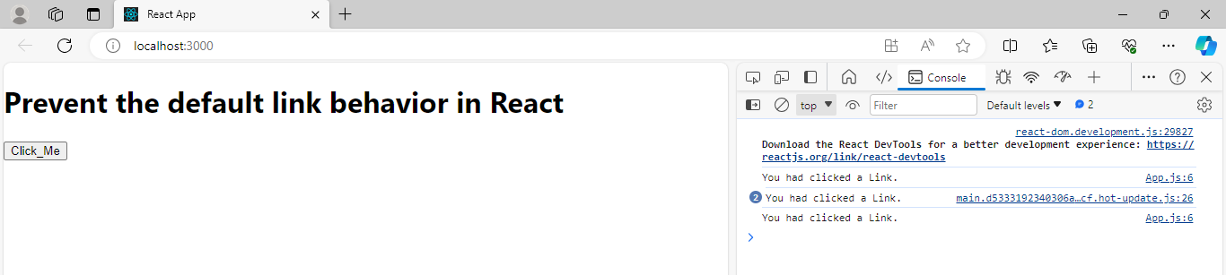
React Events- Prevent Default Link
import React from 'react';
function ActionLink() {
function handleClick(e) {
e.preventDefault();
console.log('You had clicked a Link.');
}
return (
<div>
<h1> Prevent the default link behavior in React </h1>
<button type="button" onClick={handleClick}> Click_Me </button>
</div>
);
}
export default ActionLink;

Slide 9
React Lists
Lists are used to display data in an ordered format and mainly used to display menus on websites.
In React, Lists can be created in a similar way as we create lists in JavaScript.
The map() function is used for traversing the lists.

Slide 10
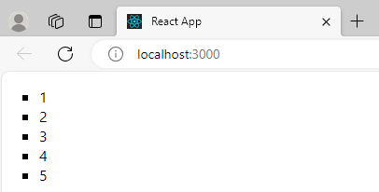
React Lists-Example 1
import React, { Component } from 'react';
class App extends Component{
render(){
const numbers = [1, 2, 3, 4, 5];
const listItems = numbers.map((numbers)=> <li>{numbers}</li> );
return (
<ul type="square">{listItems}</ul>
)
}
}
export default App;

Slide 11
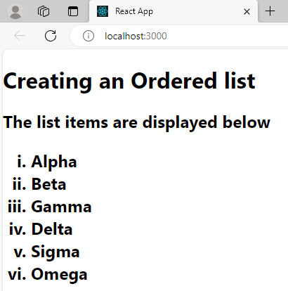
React Lists-Example 2
import React, { Component } from 'react';
class App extends Component{
render(){
const listItems = ['Alpha', 'Beta','Gamma','Delta','Sigma','Omega' ];
const list = <ol type="i">{listItems.map(item => <li>{item}</li>)}</ol>;
return (
<div>
<h1>Creating an Ordered list</h1>
<h2>The list items are displayed below {list}</h2>
</div>
);
}
}
export default App;

Slide 12
React Keys
A “key” is a special string attribute you need to include when creating lists of elements in React.
Keys allow React to keep track of elements. This way, if an item is updated or removed, only that item will be re-rendered instead of the entire list.
Generally, the key should be a unique ID assigned to each item. As a last resort, you can use the array index as a key.
Keys help React identify which items have changed, are added, or are removed. Keys should be given to the elements inside the array to give the elements a stable identity

Slide 13
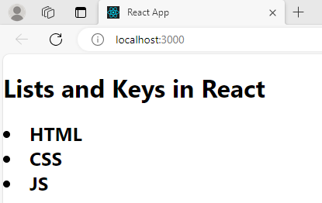
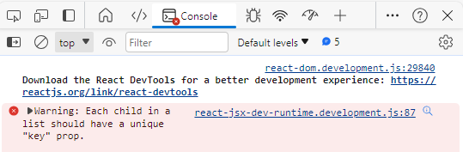
Importance of Keys
import React from "react";
function App() {
const langs = [ "HTML", "CSS", "JS"]
const output=langs.map((l) => <li>{l}</li>)
return (
<div>
<h1>Lists and Keys in React</h1>
<h2>{output}</h2>
</div>
);
}
export default App

Slide 14
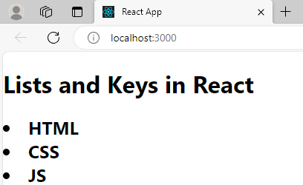
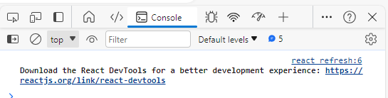
Importance of Keys
The warning can be eliminated by inserting key={index} in the map function as follows
import React from "react";
function App() {
const langs = [ "HTML", "CSS", "JS"]
const output=langs.map((l,index) => <li key={index}>{l}</li>)
return (
<div>
<h1>Lists and Keys in React</h1>
<h2>{output}</h2>
</div>
);
}
export default App
WARNING ELIMINATED

Slide 15
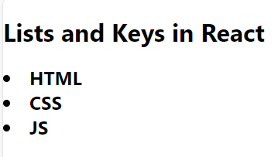
Note:
It is not recommended to use indexes for keys if the order of the item may change in future. It creates confusion for the developer and may cause issues with the component state.
Hence, instead of index each element of the array can be given an unique id as follows:
import React from "react";
function App() {
const langs = [{id:1, lang :"HTML"} ,
{id:2, lang:"CSS"},
{id:3, lang:"JS"}
]
const output=langs.map((l) => <li key={l.id}> {l.lang} </li>)
return (
<div>
<h1>Lists and Keys in React</h1>
<h2>{output}</h2>
</div>
);
}
export default App

Slide 16
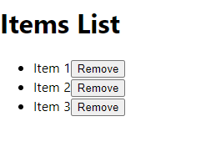
EXAMPLE 2
import React, { useState } from 'react';
const App = () => {
const [items, setItems] = useState([
{ id: 1, name: 'Item 1' },
{ id: 2, name: 'Item 2' },
{ id: 3, name: 'Item 3' },
]);
const removeItem = (id) => {
setItems(items.filter(item => item.id !== id));
};
return (
<div>
<h1>Items List</h1>
<ul>
{items.map(item => (
<li key={item.id}>
{item.name}
<button onClick={() => removeItem(item.id)}>Remove</button>
</li>
))}
</ul>
</div>
);
};
export default App;
By clicking remove button
Each item get removed

Slide 17
React Refs
Refs is the shorthand used for references in React.
It is an attribute which makes it possible to store a reference to particular DOM nodes or React elements.
It provides a way to access React DOM nodes or React elements and how to interact with it.
It is used when we want to change the value of a child component, without making the use of props.

Slide 18
When to Use Refs?
Refs can be used in the following cases:
When we need DOM measurements such as managing focus, text selection, or media playback.
It is used in triggering imperative animations.
When integrating with third-party DOM libraries.
It can also use as in callbacks.
How to create Refs
In React, Refs can be created by using React.createRef().

Slide 19
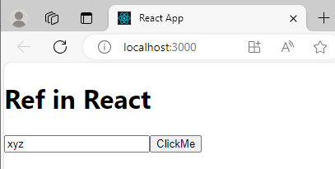
Refs - Example
import React, {Component} from 'react';
class App extends Component {
constructor (){
super()
this.userRef=React.createRef();
}
editVal()
{
this.userRef.current.focus()
this.userRef.current.value = "xyz"
}
render(){
return(
<div>
<h1>Ref in React</h1>
<input ref={this.userRef} type="text" name="user"></input>
<button onClick={() => this.editVal()}>ClickMe</button>
</div>
);
}
} export default App

Slide 20
this.userRef.current.focus():
Manages focus for the current input text box
this.userRef.current.value = “xyz”:
Assigns value to the current input text box

Slide 21
React Fragments
In React, whenever you want to render something on the screen, you need to use a render method inside the component.
This render method can return single elements or multiple elements.
However, if you want to return multiple elements, the render method will require a 'div' tag and put the entire content or elements inside it.
This extra node to the DOM sometimes results in the wrong formatting of your HTML output.

Slide 22
Why we use Fragments?
The main reason to use Fragments tag is:
It makes the execution of code faster as compared to the div tag.
It takes less memory.

Slide 23
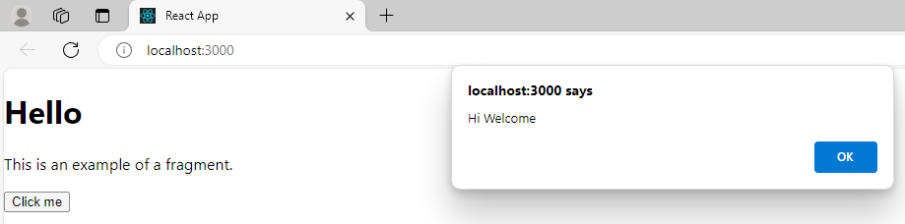
Fragments - Example
import React from 'react';
function box () {
alert("Hi Welcome")
}
function frag(){
return (
<React.Fragment>
<h1>Hello</h1>
<p>This is an example of a fragment.</p>
<button onClick= {box}>Click me</button>
</React.Fragment>
);
} export default frag;

Slide 24
React Router
React Router is a powerful routing library built on top of React that helps you add new screens and flows to your application incredibly quickly, all while keeping the URL in sync with what's being displayed on the page.
Routing is a process in which a user is directed to different pages based on their action or request. ReactJS Router is mainly used for developing Single Page Web Applications.
When a user types a specific URL into the browser, and if this URL path matches any 'route' inside the router file, the user will be redirected to that particular route.

Slide 25
Need of React Router:
React Router plays an important role to display multiple views in a single page application. Without React Router, it is not possible to display multiple views in React applications.
Most of the social media websites like Facebook, Instagram uses React Router for rendering multiple views.

Slide 26
React Router Installation
React contains three different packages for routing. These are:
react-router: It provides the core routing components and functions for the React Router applications.
react-router-native: It is used for mobile applications.
react-router-dom: It is used for web applications design.

Slide 27
React Router Installation
It is not possible to install react-router directly in your application.
To use react routing, first, you need to install react-router-dom modules in your application.
The below command is used to install react router dom.
$ npm install react-router-dom --save

Slide 28
Components in React Router
There are two types of router components:
<BrowserRouter>: It is used for handling the dynamic URL.
<HashRouter>: It is used for handling the static request.

Slide 29
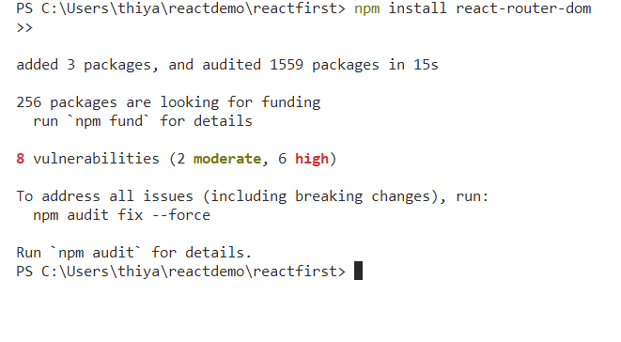
Step 1:npm install react-router-dom in terminal

Slide 30
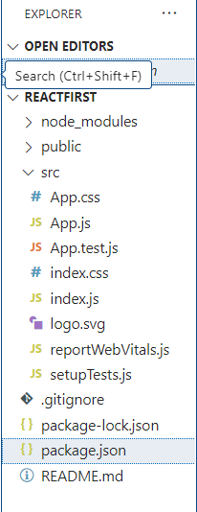
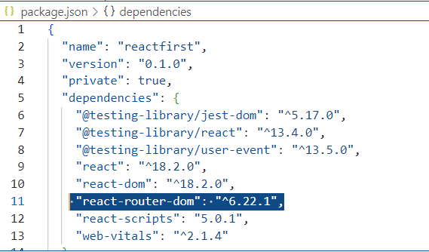
Check:React router is installed
In depecdencis-package.json

Slide 31
Index.js file-already existing file in the react
import React from 'react';
import ReactDOM from 'react-dom/client';
import './index.css';
import App from './App';
import reportWebVitals from './reportWebVitals';
const root = ReactDOM.createRoot(document.getElementById('root'));
root.render(
<React.StrictMode>
<App />
</React.StrictMode>
);

Slide 32
In Index.js file include
import React from 'react';
import ReactDOM from 'react-dom/client';
import './index.css';
import App from './App';
import reportWebVitals from './reportWebVitals’;
import { BrowserRouter } from "react-router-dom";
const root = ReactDOM.createRoot(document.getElementById('root'));
root.render(
< BrowserRouter >
<App />
</ BrowserRouter >
);

Slide 33
APP.js
import { Routes, Route } from "react-router-dom"
import Home from "./home"
import About from "./about"
import Contact from "./contact"
import Nav from "./nav"
function App() {
return (
<div>
<h1><center>MALLA REDDY UNIVERSITY</center></h1>
<Nav/>
<Routes>
<Route path=“home" element={ <Home/> } />
<Route path="about" element={ <About/> } />
<Route path="contact" element={ <Contact/> } />
</Routes>
</div>
)
}
export default App

Slide 34
about.js
import React from 'react' function about() {
return (
<div>
<h2>Malla Reddy University, Hyderabad (As per Telangana State Private Universities Act No. 13 of 2020, Higher Education (UE) Department dt. 15.6.2020) was established in the year 2020 through the State Legislature Council of Telangana, Govt. of Telangana. It is offering industry-focused specialised Undergraduate and Postgraduate courses with the aim of providing Quality Higher Education on par with International standards. It persistently seeks and adopts innovative methods to improve the quality of higher education on a consistent basis. </h2>
</div>
)
}
export default about

Slide 35
home.js
import React from 'react' function Home() {
return (
<div>
<h1>PROGRAMMES OFFERED</h1>
<h2> <li>School ofEngineering</li>
<li>School of Agricultural Sciences</li>
<li>School of Allied Healthcare Sciences</li>
<li>School of Management</li>
<li>School of Sciences</li>
<li>School of Commerce & Arts</li>
</h2>
</div>
);
} export default Home;

Slide 36
contact.js
import React from 'react' function Contact() {
return (
<div>
<h1>Maisammaguda, Dulapally,
Hyderabad, Telangana 500100<br></br>
Phone: 94971-94971, 91778-78365<br></br>
info@mallareddyuniversity.ac.in<br></br>
admissions@mallareddyuniversity.ac.in</h1>
</div>
)
}
export default Contact

Slide 37
nav.js
import { Link } from 'react-router-dom'
const Nav = () => {
return(
<nav>
<ul>
<li><Link to="/home">Home</Link></li>
<li><Link to="/about">About</Link></li>
<li><Link to="/contact">Contact</Link></li>
</ul>
</nav>
)
}
export default Nav;

Slide 38
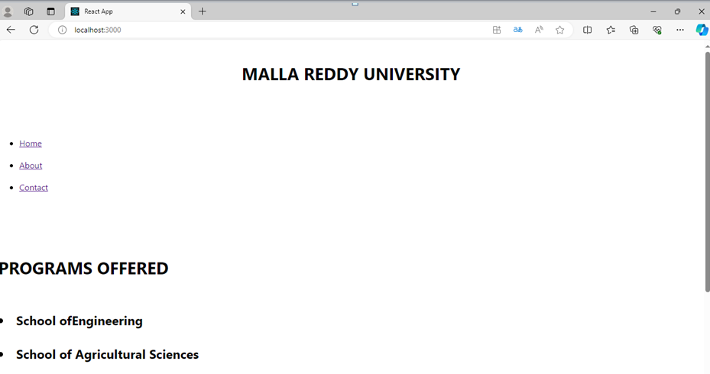

Slide 39


Slide 40
React Styling using React Bootstrap
React-Bootstrap is a front-end UI component library built with React. It is used to build responsive, mobile-first projects on the web.
React-Bootstrap provides a wide range of components, including buttons, navbars, tabs, cards, and modals.
It also provides a number of layout components, such as grids and containers.
React-Bootstrap is easy to use and well-documented. It is a popular choice for building React applications, and it is used by companies like Facebook, Twitter, and Airbnb.

Slide 41
Adding Bootstrap for React
Bootstrap can be added to the React app in several ways.
The three most common ways are given below:
Using the Bootstrap CDN
Bootstrap as Dependency
React Bootstrap Package

Slide 42
1. Using the Bootstrap CDN
There is no need to install or download Bootstrap.
We can simply put an <link> into the <head> section of the index.html file of the React app as shown in the following snippet.
<link rel="stylesheet" href="https://stackpath.bootstrapcdn.com/bootstrap/4.3.1/css/bootstrap.min.css" integrity="sha384ggOyR0iXCbMQv3Xipma34MD+dH/1fQ784/j6cY/iJTQUOhcWr7x9JvoRxT2MZw1T" crossorigin="anonymous">

Slide 43
2. Bootstrap as Dependency
If we are using a build tool or a module bundler such as Webpack, then importing Bootstrap as dependency is the preferred option for adding Bootstrap to the React application.
We can install Bootstrap as a dependency for the React app.
To install the Bootstrap, run the following commands in the terminal window.
npm install bootstrap

Slide 44
3.React Bootstrap Package
The two most popular Bootstrap packages are:
1.react-bootstrap:
It is a complete re-implementation of the Bootstrap components as React components.
It does not need any dependencies like bootstrap.js or jQuery.
If the React setup and React-Bootstrap installed, we have everything which we need.

Slide 45
2.reactstrap:
It is a library which contains React Bootstrap 4 components that favor composition and control.
It does not depend on jQuery or Bootstrap JavaScript.
However, react-popper is needed for advanced positioning of content such as Tooltips, Popovers, and auto-flipping Dropdowns.

Slide 46
Installation
After creating the React app, the best way to install Bootstrap is via the npm package. To install Bootstrap, navigate to the React app folder, (c:/Users/MRUH/myfolder/myapp>)and run the following command.
npm install react-bootstrap

Slide 47
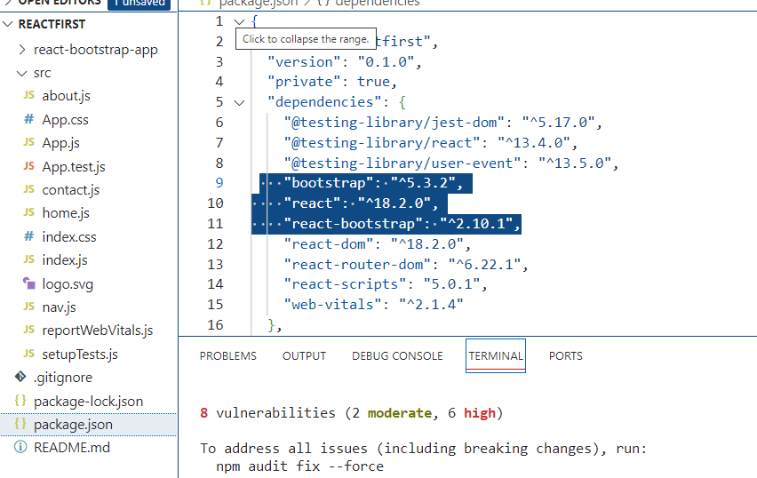
In package.json bootstrap module is installed
Now, React Bootstrap is successfully installed in our project.

Slide 48
Adding Stylesheets
The React Bootstrap component does not contain styles to provide them; we have to add the bootstrap stylesheets to our application.
To add the stylesheets, import them into your app.js or index.js file. To import the CSS file, include the following line in the import section (top) of the file:
import 'bootstrap/dist/css/bootstrap.min.css';

Slide 49
Example- Bootstrap
import 'bootstrap/dist/css/bootstrap.min.css';
import {Button} from 'react-bootstrap'
var myStyle = {
textAlign:'center',
fontFamily: 'Courier',
}
function App() {
return (
<div className="App" style={myStyle}>
<h1>MALLA REDDY UNIVERSITY</h1>
<Button className='m-5' variant="primary">HOME</Button>
<Button className='m-5' variant="secondary">ABOUT US</Button>
<Button className='m-5' variant="success">CONTACT</Button>
<Button className='m-5' variant="danger">GALLARY</Button>
<Button className='m-5' variant="primary">NEWS</Button>
</div>
);
}
export default App;

Slide 50
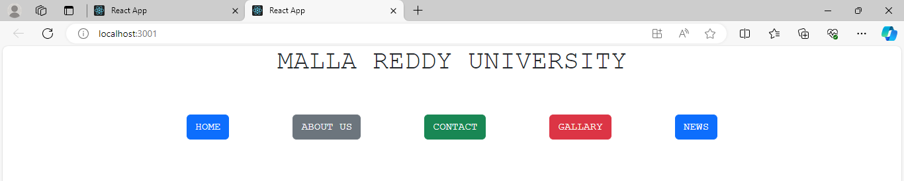
Example- Bootstrap-OUTPUT

Slide 51
React Map
A map is a data collection type where data is stored in the form of pairs.
It contains a unique key. The value stored in the map must be mapped to the key.
We cannot store a duplicate pair in the map(). It is because of the uniqueness of each stored key. It is mainly used for fast searching and looking up data.
The map() method creates a new array by calling a provided function on every element in the calling array.
In React, the map method is used to :
Traversing the list element.
Traversing the list element with keys.
Example:
var numbers = [1, 2, 3, 4, 5];
const doubleValue = numbers.map((number)=>{
return (number * 2);
});
console.log(doubleValue);

Slide 52
React Table
A table is an arrangement which organizes information into rows and columns. It is used to store and display data in a structured format.
Features:
It is lightweight at 11kb (and only need 2kb more for styles).
It is fully customizable (JSX, templates, state, styles, callbacks).
It is fully controllable via optional props and callbacks.
It has client-side & Server-side pagination.
It has filters.
Pivoting & Aggregation
Minimal design & easily themeable

Slide 53
React Table
React Table (now TanStack Table) is a popular open-source library for building tables and datagrids in React applications. It provides a flexible and performant foundation for creating interactive and visually appealing tables with features like:
Core Functionalities:
Sorting: Allows users to sort data by clicking on column headers.
Filtering: Enables users to search and filter data based on specific criteria.
Pagination: Facilitates managing large datasets by displaying data in smaller, manageable portions with navigation for browsing through pages.
Additional Capabilities: Virtualization: Enhances performance by rendering only visible rows, improving scrolling experience for large datasets. Customizable: Offers flexibility to tailor the table's appearance and behavior to your specific needs through hooks and options. Headless: Does not enforce a specific UI or styles, allowing you to control the look and feel of the table through custom CSS or design systems.

Slide 54
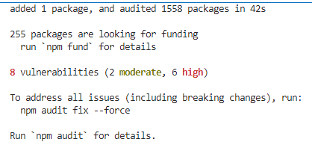
React Table- Installation
Step 1:
Type the following command in the Terminal:
c:\Users\SOE-III\myfolder\myapp> npm install react-table
Step 2: import the react-table into the react component. To do this, add the following statement to the App.js file:
import ReactTable from "react-table";

Slide 55
React Table- Example
App.js File
import React from 'react';
import './App.css'
function App() {
return (
<div >
<h1>Table using React</h1>
<table>
<tr>
<th>Name</th>
<th>Age</th>
<th>Gender</th>
</tr>
<tr>
<td>Anish</td>
<td>19</td>
<td>Male</td>
</tr>
<tr>
<td>Megha</td>
<td>19</td>
<td>Female</td>
</tr>
<tr>
<td>Subham</td>
<td>25</td>
<td>Male</td>
</tr>
</table>
</div>
);
}
export default App;

Slide 56
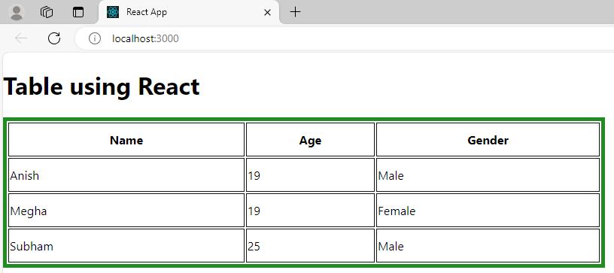
React Table- Example
App.css File
table {
border: 5px solid forestgreen;
width: 800px;
height: 200px;
}
th,td {
border: 1px solid rgb(19, 20, 19);
}

Slide 57
React Higher-Order Components (HOC)
It is also known as HOC. In React, HOC is an advanced technique for reusing component logic.
It is a component that takes another component as input and returns a new component with extra features added to the original component.
A higher order component function accepts another function as an argument.
The main goal of this is to decompose the component logic into simpler and smaller functions that can be reused as you need.

Slide 58
React Higher-Order Components (HOC)-Example
A function is said to be Higher Order Component if:
Case 1: If another function is called into this function or
Case-2: If another function is returned from this function
function High(example) {
return (props) => {
Return <example {… props}/>
}
}
Case1 eg.: Function example is called into the function High. Therefore, High is called HOC
function App() {
return (
<p>example name =“John”</p>
)}
Example:
function example(props) {
return (
<p> Hello {props.name} </p>
)}
Case2 eg.: Function example is returned from App function. Hence, App is HOC

Slide 59
Example-HOC
//Function Creation
function add (a, b) {
return a + b
}
function higherOrder(a, addReference) {
return addReference(a, 20)
}
//Function call
higherOrder(30, add) // 50

Slide 60
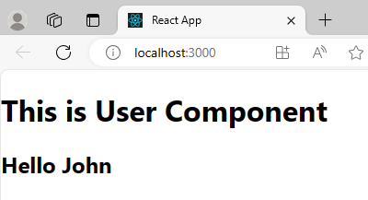
import React from 'react';
function AuthCheck(Comp) {
let authenticated=true;
return(abc) => {
if(authenticated) {
return <Comp {...abc} />
}
else {
return <Login/>
}
}
}
function User(x) {
return(
<div>
<h1> This is User Component</h1>
<h2> Hello {x.username}</h2>
</div>
);
}
function Login() {
return(
<h1> This is Login Component </h1>
)
}
const AuthChecked = AuthCheck(User)
function App(){
return (
<AuthChecked username={"John"}/>
)
}
export default App;

Slide 61
React Higher-Order Components (HOC)-Example
HOC.js File
import React, {Component} from 'react';
function Hoc (HocComponent){
return class extends Component{
render(){
return (
<div>
<HocComponent/>
</div>
);
}
}
} export default Hoc

Slide 62
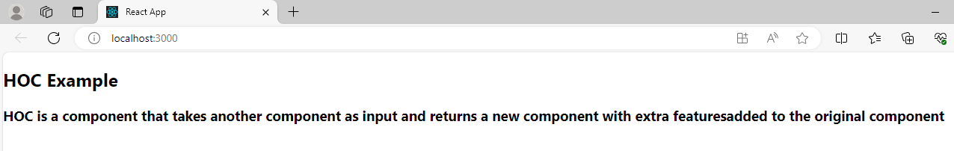
React Higher-Order Components (HOC)-Example
App.js File
import React, { Component } from 'react';
import HOC from './HOC';
class App extends Component {
render() {
return (
<div>
<h2>HOC Example</h2>
<h3>HOC is a component that takes another component as input and returns a new component with extra features added to the original component</h3>
</div>
)
}
}
App = HOC(App);
export default App;

Slide 63
React Code Splitting
The React app bundles their files using tools like Webpack or Browserfy.
Bundling is a process in which multiple files are merged into a single file, which is called a bundle.
The bundle is responsible for loading an entire app at once on the webpage.
Code-Splitting is a feature supported by Webpack and Browserify, which can create multiple bundles that can be dynamically loaded at runtime.
Code splitting uses React.lazy and Suspense tool/library, which helps to load a dependency lazily and only load it when needed by the user.

Slide 64
Why Do We Need Code Splitting?
When building large-scale applications, the JavaScript bundle can become quite large, which can impact the load time of the application.
Code splitting is a technique where we split our code into various bundles which can then be loaded on demand or in parallel.
This can significantly reduce the load time of our application.

Slide 65
React.lazy
React.lazy is a function that lets you render a dynamic import as a regular react component.
It makes it possible to load components lazily, which can be very useful for reducing the size of the initial JavaScript bundle that the user's browser has to download and parse.
Without using React.lazy function:
import ExampleComponent from './ExampleComponent';
Using React.lazy function:
const ExampleComponent = React.lazy(() => import('./ExampleComponent'));

Slide 66
<suspense>
the <suspense> component is responsible for handling the output when the lazy component is fetched and rendered.
const ExampleComponent = React.lazy(() => import('./ ExampleComponent'));
function MyComponent() {
return (
<div>
<Suspense fallback={<div>Loading...</div>}>
<ExampleComponent />
</Suspense>
</div>
);
}
NOTE:
The fallback prop accepts the React elements which you want to render while waiting for the component to load.
We can combine multiple lazy components with a single Suspense component.

Slide 67
Example-Code Splitting
about.js file:
import React from 'react'
function about() {
return (
<div>
<h2>Malla Reddy University, Hyderabad (As per Telangana State Private Universities Act No. 13 of 2020, Higher Education (UE) Department dt. 15.6.2020) was established in the year 2020 through the State Legislature Council of Telangana, Govt. of Telangana. It is offering industry-focused specialised Undergraduate and Postgraduate courses with the aim of providing Quality Higher Education on par with International standards. It persistently seeks and adopts innovative methods to improve the quality of higher education on a consistent basis. </h2>
</div>
)
}
export default about

Slide 68
Example-Code Splitting
home.js file:
import React from 'react'
function Home() {
return (
<div>
<h1>PROGRAMMES OFFERED</h1>
<h2> <li>School ofEngineering</li>
<li>School of Agricultural Sciences</li>
<li>School of Allied Healthcare Sciences</li>
<li>School of Management</li>
<li>School of Sciences</li>
<li>School of Commerce & Arts</li>
</h2>
</div>
);
}
export default Home;

Slide 69
Example-Code Splitting
check.js file:
import React, {useState, lazy, Suspense} from 'react';
const About=lazy(() => import('./about'));
const Home=lazy(() => import('./home')); function Selection() {
const [selectedTab,setSelectedTab] = useState('');
return(
<div>
<div>
<button onClick={ () => setSelectedTab ('homeTab')}> Home</button>
<button onClick={ () => setSelectedTab ('aboutTab')}> About</button>
</div>
<Suspense fallback={<div> Loading....</div>}>
{selectedTab === 'homeTab' && <Home/>}
{selectedTab === 'aboutTab' && <About/>}
</Suspense>
</div>
)
} export default Selection;

Slide 70
Example-Code Splitting
app.js file:
import React, {Component} from 'react';
import Selection from './check.js';
class App extends Component {
render (){
return (
<div>
< Selection />
</div>
);
}
}
export default App;

Slide 71
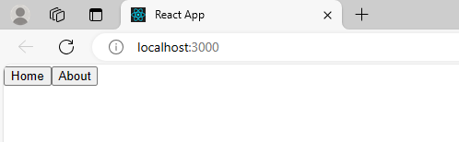
OUTPUT:

Slide 72
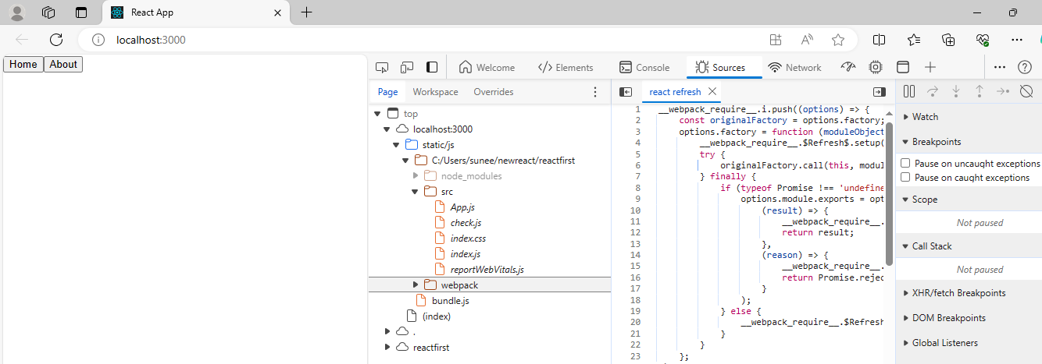
Only these 5 files are rendered before the buttons are pressed

Slide 73
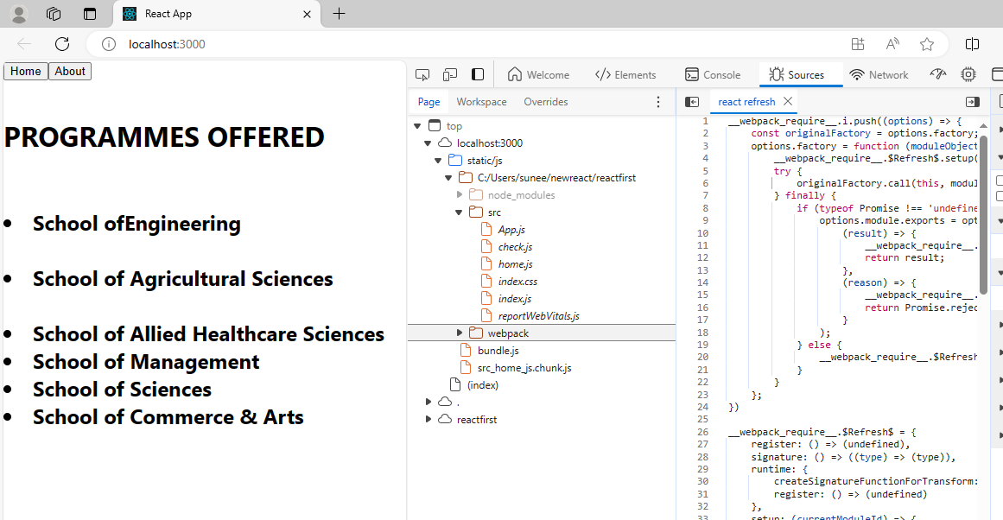
When the user clicks on Home Button, home.js file is added to the existing list

Slide 74
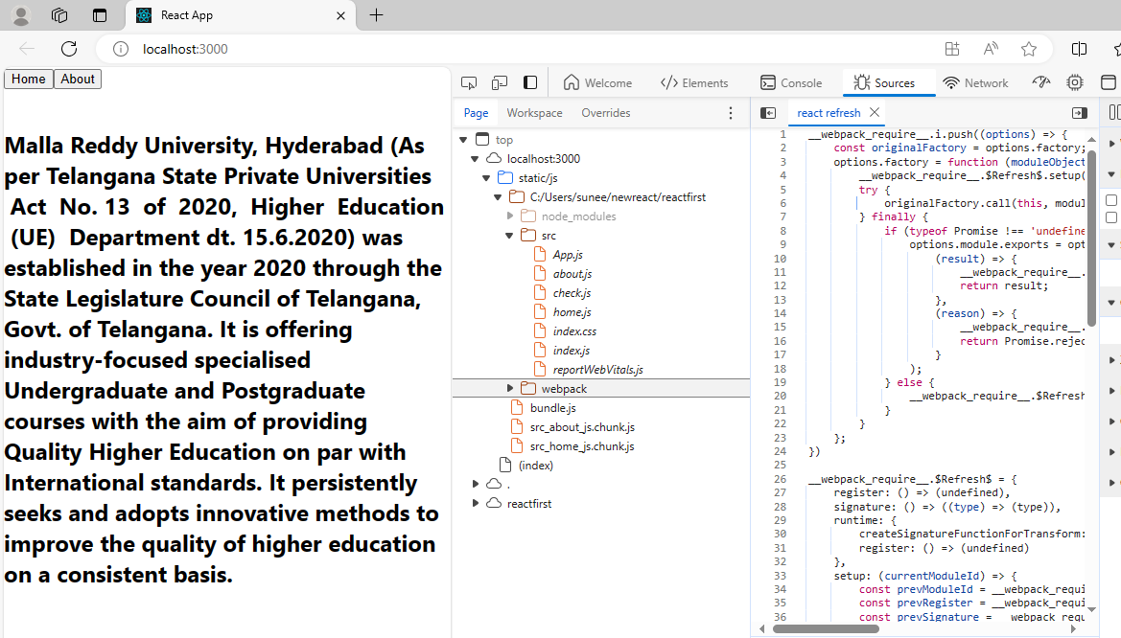
Now, when the user clicks on the about button, about.js file is rendered.

Slide 75
React Context
Context allows passing data through the component tree without passing props down manually at every level.
Context provides a way to pass values between components without explicitly passing a prop through every level of the component tree.
How to use Context ?
There are two main steps to use the React context into the React application:
Setup a context provider and define the data which you want to store.
Use a context consumer whenever you need the data from the store

Slide 76
React Context
To pass the data from parent component to ChildC component , first its has to be passed to ChildA then to ChildB and then to ChildC component.
React Context allows us to directly pass the data from the parent component any child component directly.
For this, we need to have the following:
Data
Provider (component which will pass the data)
Consumer (component which will receive the data)
Parent
ChildA
ChildB
ChildC

Slide 77
React Context – Example without using Context
App.js File:
import React from 'react';
import ChildA from './childA';
function App(){
const name = "MRUH"
return(
<div>
<ChildA name ={name}/>
</div>
);
}
export default App;
childA.js File:
import React from 'react';
import ChildB from './childB';
function ChildA({name}){
return(
<div>
<ChildB name ={name}/>
</div>
);
}
export default ChildA;

Slide 78
React Context – Example without using Context
childB.js File:
import React from 'react';
import ChildC from './childC';
function ChildB({name}){
return(
<div>
<ChildC name ={name}/>
</div>
);
}
export default ChildB;
childC.js File:
import React from 'react';
function ChildC({name}){
return(
<div>
<h1>Malla Reddy University {name}</h1>
</div>
);
}
export default ChildC;

Slide 79
NOTE:
In the previous example the data with variable “name” is passed from the parent component i.e., App.js file to childA → childB → childC.
But, with the use of React Context we can pass the data directly from App.js component to childC.js component.

Slide 80
React Context – Example using Context
Modified childB.js File:
import React from 'react';
import ChildC from './childC';
function ChildB(){
return(
<div>
<ChildC/>
</div>
);
}
export default ChildB;
Modified childA.js File:
import React from 'react';
import ChildB from './childB';
function ChildA(){
return(
<div>
<ChildB name =/>
</div>
);
}
export default ChildA;

Slide 81
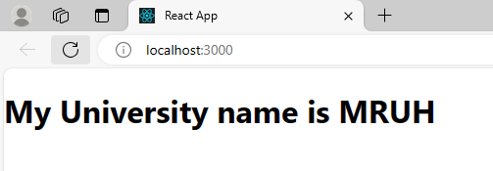
React Context – Example- using Context
Modified App.js File:
import React, {createContext} from 'react';
import ChildA from './childA';
const data = createContext();
function App(){
const name = "MRUH"
return(
<div>
<data.Provider value ={name}>
<ChildA/>
</data.Provider>
</div>
);
}
export default App;
export {data};
Modified childC.js File:
import React from 'react';
import {data} from './App'
function ChildC(){
return(
<div>
<data.Consumer>
{
(name) => {
return(
<h1>My University name is {name}</h1>
)
}
}
</data.Consumer>
</div>
);
} export default ChildC;

Slide 82
React Hooks
Hooks are the new feature introduced in the React 16.8 version.
It allows you to use state and other React features without writing a class.
It does not work inside classes.
When to use Hooks?
If you write a function component, and then you want to add some state to it, previously you do this by converting it to a class.
But, now you can do it by using a Hook inside the existing function component.

Slide 83
Rules of Hooks
1. Only call Hooks at the top level:
Do not call Hooks inside loops, conditions, or nested functions. Hooks should always be used at the top level of the React functions. This rule ensures that Hooks are called in the same order each time a components renders.
2. Only call Hooks from React functions:
You cannot call Hooks from regular JavaScript functions. Instead, you can call Hooks from React function components. Hooks can also be called from custom Hooks.
Pre-requisites for React Hooks:
Node version 6 or above
NPM version 5.2 or above
Create-react-app tool for running the React App

Slide 84
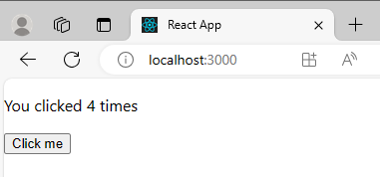
Hooks Example
import React, { useState } from 'react';
function CountApp() {
// Declare a new state variable, which we'll call "count"
const [count, setCount] = useState(0);
return (
<div>
<p>You clicked {count} times</p>
<button onClick={() => setCount(count + 1)}>
Click me
</button>
</div>
);
}
export default CountApp;

Slide 85
React Redux
It is a state management library
Redux is not tied to React.
It can be used with React, Angular, Vue etc.
It is a library for Javascript applications
Redux is a State Container:
Redux stores the state of your Application(App)
State of an App is the state represented by all the individual components of that App
e.g: state ={
username : ‘1’}

Slide 86
Redux is a State Container:
Redux stores the state of your Application(APP)
State of an APP is the state represented by all the individual components of that APP
e.g: state ={
username : ‘1’,
password : ‘*****’
submitted: ‘false’
}
Redux will store and manage the APP state

Slide 87
Redux is a Predictable:
Redux is a predictable state container for Javascript Apps
React
React-Redux
Redux
React and Redux works independently of each other
To directly use redux in React is bit confusing and difficult, hence we use React-Redux package in between React and Redux.

Slide 88
React Redux
Redux is an open-source JavaScript library used to manage application state. React uses Redux for building the user interface.
React Redux is the official React binding for Redux. It allows React components to read data from a Redux Store, and dispatch Actions to the Store to update data.
Redux helps apps to scale by providing a sensible way to manage state through a unidirectional data flow model. React Redux is conceptually simple.
It subscribes to the Redux store, checks to see if the data which your component wants have changed, and re-renders your component.

Slide 89
use React Redux
React Redux is the official UI bindings for react Application. It is kept up-to-date with any API changes to ensure that your React components behave as expected.
It encourages good 'React' architecture.
It implements many performance optimizations internally, which allows to components re-render only when it actually needs.

Slide 90
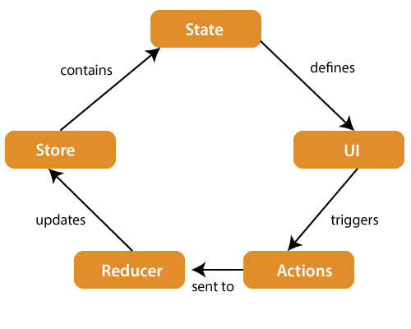
Redux Architecture

Slide 91
The components of Redux architecture are explained below.
STORE: A Store is a place where the entire state of your application lists. It manages the status of the application and has a dispatch(action) function. It is like a brain responsible for all moving parts in Redux.
ACTION: Action is sent or dispatched from the view which are payloads that can be read by Reducers. It is a pure object created to store the information of the user's event. It includes information such as type of action, time of occurrence, location of occurrence, its coordinates, and which state it aims to change.
REDUCER: Reducer read the payloads from the actions and then updates the store via the state accordingly. It is a pure function to return a new state from the initial state.

Slide 92
What are the core principles of Redux?
Redux follows three fundamental principles:
Single source of truth: The state of your whole application is stored in an object tree within a single store. The single state tree makes it easier to keep track of changes over time and debug or inspect the application.
State is read-only: The only way to change the state is to emit an action, an object describing what happened. This ensures that neither the views nor the network callbacks will ever write directly to the state.
Changes are made with pure functions: To specify how the state tree is transformed by actions, you write reducers. Reducers are just pure functions that take the previous state and an action as parameters, and return the next state.

Slide 93
THANK YOU

